Slide 1


Hormones and Recombinant DNA Technology
Ch 2 HP, Ch 13 HP

Slide 2
Recombinant DNA Technology
Process of splicing DNA from one organism into another organism
Variety of uses.
Endocrine System uses of recombinant DNA Technology:
Synthetic Insulin
Synthetic Growth Hormone

Slide 3
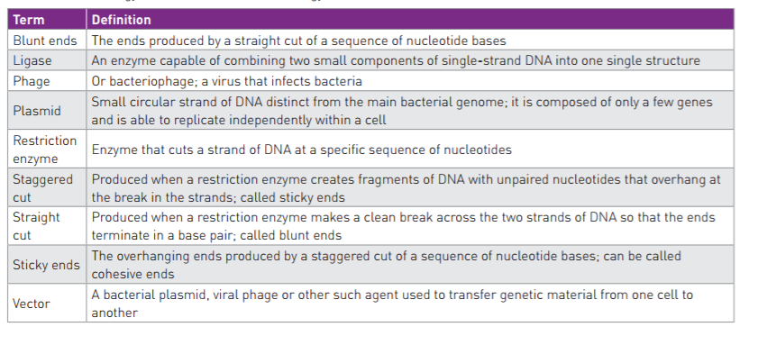

Slide 4
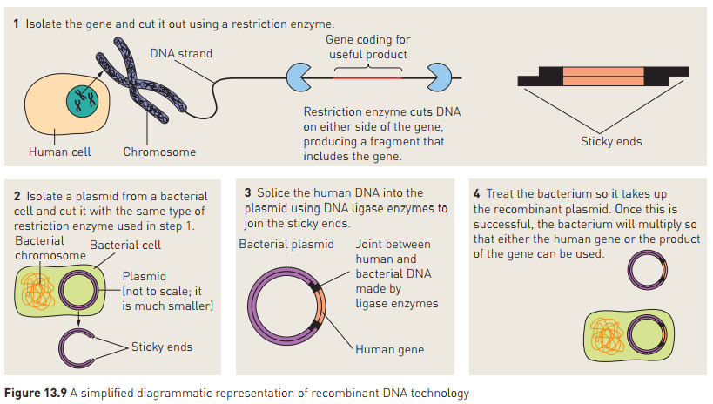

Slide 5
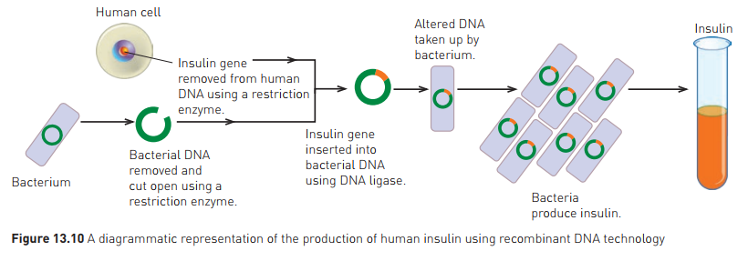
Examples of use
Insulin
Pre-1982, diabetics treated with insulin from pig/cattle pancreas
1982: insulin produced from genetically engineered bacteria approved.
Human gene spliced into bacterial cells, so bacteria would then produce insulin
Insulin now produced in huge vats of bacteria.

Slide 6
Examples of use cont…
Human Growth Hormone
Now produced by genetically engineered E. coli bacteria
Used to treat lack of growth hormone in pituitary disorders
Also used in cattle to increase milk production

